Slide 1



Discrete Mathematics 2025 Spring
魏可佶 kejiwei@tongji.edu.cn

Slide 2
Chapter 3： First Order Logic
3.1 Basic Concepts of First-Order Logic
3.2 Equivalence Calculus of First-Order Logic
Notes:
3.1 一阶逻辑基本概念
3.2 一阶逻辑等值演算

Slide 3
3.1 Basic Concepts of First-Order Logic
3.1.1 The Limitations of Propositional Logic
3.1.2 Individual Terms, Predicates, and Quantifiers
3.1.3 Symbolization of First-Order Logic
3.1.4 First-Order Logic Formulas and Classification
Notes:
Individual Constants, Individual Variables, Domain of Discourse, Universe of Discourse
Propositional Constants, Propositional Variables
Universal Quantifiers, Existential Quantifiers
First-order language L (alphabet, terms, atomic formulas, compound formulas)
Scope and bound variables, bound occurrences and free occurrences
Closed formulas
Interpretation of first-order language L
Tautologies, contradictions, and satisfiable formulas
Substitution examples
3.1.1 命题逻辑的局限性
3.1.2 个体词、谓词与量词
个体常项、个体变项、个体域、全总个体域
谓词常项、谓词变项
全称量词、存在量词
3.1.3 一阶逻辑命题符号化

Slide 4
3.1.1 The Limitations of Propositional Logic
⤷ The key limitations of propositional logic
Inability to express individual relationships :
It treats statements as whole units without using variables (x) and predicates (H(x), M(x)) to represent properties.
For example, it can only express "All humans are mortal" as a single proposition, not as ∀x(H(x)→M(x)), which specifies the relationship for each individual.
Inability to perform generalization and instantiation reasoning: Propositional logic cannot express the general statement "All humans are mortal" (∀x(H(x)→M(x)), It cannot derive M(s) from (∀x(H(x)→M(x) and H(s), as it only combines concrete propositions without handling universal (∀) or existential (∃) quantification.
Notes:
在逻辑学中，命题是表达断定性陈述的语句，它可以被判断为真或假。
命题的内部结构通常包括对象、属性、数量或范围、逻辑连接词等要素。
命题逻辑专注于命题之间的逻辑关系，不涉及命题内部的结构。例如，“今天是晴天”或“苏格拉底是人”都是命题。命题逻辑关注的是这些命题如何通过逻辑连接词组合起来形成更复杂的陈述。
一个有效的逻辑论断意味着其结论在所有前提为真的情况下也必定为真，并不意味着论断本身必须在所有情况下都为真，只是说在其特定的前提为真的情况下，结论也为真。
重言式是一种特殊类型的命题，不依赖于任何特定前提，它在所有情况下都是真的。
命题逻辑与一阶逻辑的区别？
命题逻辑和一阶逻辑是逻辑学中的两个基本分支，它们在表达能力和应用范围上有显著的区别：
表达能力：
命题逻辑：是逻辑学的一个基础分支，主要关注于命题之间的逻辑关系。它处理的是整个命题的真假，而不涉及命题内部的结构。命题逻辑中的基本单位是命题，例如“今天下雨”或“火车晚点”。命题逻辑使用逻辑联结词（如“和”，“或”，“非”）来构造更复杂的命题。
一阶逻辑：也称谓词逻辑，是逻辑学的另一个重要分支，它在命题逻辑的基础上增加了量词（如“所有”，“存在”）和谓词（可以理解为属性或关系）。一阶逻辑可以表达命题内部的结构，比如“所有人都是凡人”或“存在一只猫是黑色的”。这使得一阶逻辑在表达能力上更加强大和灵活。
形式化：
命题逻辑的形式化相对简单，因为它只涉及到整个命题的真假。
一阶逻辑的形式化更加复杂，因为它需要处理个体、谓词、量词等更复杂的元素。
应用范围：
命题逻辑主要用于分析和推理那些可以被整体性描述的情况。
一阶逻辑由于其表达能力更强，因此在数学、计算机科学、语言学等领域有更广泛的应用。它能够描述和推理个体之间的关系以及属性。
推理复杂性：
命题逻辑的推理通常比一阶逻辑简单，因为它处理的结构更为直接和简单。
一阶逻辑的推理更加复杂，特别是当涉及到量词和谓词的时候。
总的来说，一阶逻辑在表达能力上更为强大，可以表达个体之间的复杂关系，而命题逻辑则更加简洁，适用于处理整体性的命题。

Slide 5
3.1.1 The Limitations of Propositional Logic
⤷ The key limitations of propositional logic (cont.)
Lack of expressive power in predicate logic: Propositional logic cannot describe relationships between different individuals (e.g., parent-child relationships, size comparisons).
For example, it cannot express the existential statement "Some people are mortal" ∃xM(x).
Example: Theorem proof
Suppose we have a mathematical theorem: If a number is even, then it is divisible by 2.
Specific proposition: "4 is even." Conclusion: "4 is divisible by 2."
Notes:
在逻辑学中，命题是表达断定性陈述的语句，它可以被判断为真或假。
命题的内部结构通常包括对象、属性、数量或范围、逻辑连接词等要素。
命题逻辑专注于命题之间的逻辑关系，不涉及命题内部的结构。例如，“今天是晴天”或“苏格拉底是人”都是命题。命题逻辑关注的是这些命题如何通过逻辑连接词组合起来形成更复杂的陈述。
一个有效的逻辑论断意味着其结论在所有前提为真的情况下也必定为真，并不意味着论断本身必须在所有情况下都为真，只是说在其特定的前提为真的情况下，结论也为真。
重言式是一种特殊类型的命题，不依赖于任何特定前提，它在所有情况下都是真的。
命题逻辑与一阶逻辑的区别？
命题逻辑和一阶逻辑是逻辑学中的两个基本分支，它们在表达能力和应用范围上有显著的区别：
表达能力：
命题逻辑：是逻辑学的一个基础分支，主要关注于命题之间的逻辑关系。它处理的是整个命题的真假，而不涉及命题内部的结构。命题逻辑中的基本单位是命题，例如“今天下雨”或“火车晚点”。命题逻辑使用逻辑联结词（如“和”，“或”，“非”）来构造更复杂的命题。
一阶逻辑：也称谓词逻辑，是逻辑学的另一个重要分支，它在命题逻辑的基础上增加了量词（如“所有”，“存在”）和谓词（可以理解为属性或关系）。一阶逻辑可以表达命题内部的结构，比如“所有人都是凡人”或“存在一只猫是黑色的”。这使得一阶逻辑在表达能力上更加强大和灵活。
形式化：
命题逻辑的形式化相对简单，因为它只涉及到整个命题的真假。
一阶逻辑的形式化更加复杂，因为它需要处理个体、谓词、量词等更复杂的元素。
应用范围：
命题逻辑主要用于分析和推理那些可以被整体性描述的情况。
一阶逻辑由于其表达能力更强，因此在数学、计算机科学、语言学等领域有更广泛的应用。它能够描述和推理个体之间的关系以及属性。
推理复杂性：
命题逻辑的推理通常比一阶逻辑简单，因为它处理的结构更为直接和简单。
一阶逻辑的推理更加复杂，特别是当涉及到量词和谓词的时候。
总的来说，一阶逻辑在表达能力上更为强大，可以表达个体之间的复杂关系，而命题逻辑则更加简洁，适用于处理整体性的命题。

Slide 6
3.1.1 The Limitations of Propositional Logic
⤷ The key limitations of propositional logic (cont.)
In first-order logic: ∀x(E(x)→D(x)) (All even numbers are divisible by 2). E(4) (4 is even). Conclusion: D(4) (4 is divisible by 2).
Using propositional logic: Let P represent "All even numbers are divisible by 2." Let Q represent "4 is even." Let R represent "4 is divisible by 2." The reasoning takes the form: (P∧Q)→R.
Problem: P is just a single proposition and cannot analyze its internal quantification ∀x(E(x)→D(x)) It cannot perform instantiation reasoning (e.g., it cannot directly derive "4 is divisible by 2" from "All even numbers are divisible by 2").
Notes:
在逻辑学中，命题是表达断定性陈述的语句，它可以被判断为真或假。
命题的内部结构通常包括对象、属性、数量或范围、逻辑连接词等要素。
命题逻辑专注于命题之间的逻辑关系，不涉及命题内部的结构。例如，“今天是晴天”或“苏格拉底是人”都是命题。命题逻辑关注的是这些命题如何通过逻辑连接词组合起来形成更复杂的陈述。
一个有效的逻辑论断意味着其结论在所有前提为真的情况下也必定为真，并不意味着论断本身必须在所有情况下都为真，只是说在其特定的前提为真的情况下，结论也为真。
重言式是一种特殊类型的命题，不依赖于任何特定前提，它在所有情况下都是真的。
命题逻辑与一阶逻辑的区别？
命题逻辑和一阶逻辑是逻辑学中的两个基本分支，它们在表达能力和应用范围上有显著的区别：
表达能力：
命题逻辑：是逻辑学的一个基础分支，主要关注于命题之间的逻辑关系。它处理的是整个命题的真假，而不涉及命题内部的结构。命题逻辑中的基本单位是命题，例如“今天下雨”或“火车晚点”。命题逻辑使用逻辑联结词（如“和”，“或”，“非”）来构造更复杂的命题。
一阶逻辑：也称谓词逻辑，是逻辑学的另一个重要分支，它在命题逻辑的基础上增加了量词（如“所有”，“存在”）和谓词（可以理解为属性或关系）。一阶逻辑可以表达命题内部的结构，比如“所有人都是凡人”或“存在一只猫是黑色的”。这使得一阶逻辑在表达能力上更加强大和灵活。
形式化：
命题逻辑的形式化相对简单，因为它只涉及到整个命题的真假。
一阶逻辑的形式化更加复杂，因为它需要处理个体、谓词、量词等更复杂的元素。
应用范围：
命题逻辑主要用于分析和推理那些可以被整体性描述的情况。
一阶逻辑由于其表达能力更强，因此在数学、计算机科学、语言学等领域有更广泛的应用。它能够描述和推理个体之间的关系以及属性。
推理复杂性：
命题逻辑的推理通常比一阶逻辑简单，因为它处理的结构更为直接和简单。
一阶逻辑的推理更加复杂，特别是当涉及到量词和谓词的时候。
总的来说，一阶逻辑在表达能力上更为强大，可以表达个体之间的复杂关系，而命题逻辑则更加简洁，适用于处理整体性的命题。

Slide 7
3.1 Basic Concepts of First-Order Logic
3.1.1 The Limitations of Propositional Logic
3.1.2 Individual Terms, Predicates, and Quantifiers
Individual Constants, Individual Variables, Domain of Discourse, Universe of Discourse
Propositional Constants, Propositional Variables
Universal Quantifiers, Existential Quantifiers
3.1.3 Symbolization of First-Order Logic
3.1.4 First-Order Logic Formulas and Classification
Notes:
Individual Constants, Individual Variables, Domain of Discourse, Universe of Discourse
Propositional Constants, Propositional Variables
Universal Quantifiers, Existential Quantifiers
First-order language L (alphabet, terms, atomic formulas, compound formulas)
Scope and bound variables, bound occurrences and free occurrences
Closed formulas
Interpretation of first-order language L
Tautologies, contradictions, and satisfiable formulas
Substitution examples
3.1.1 命题逻辑的局限性
3.1.2 个体词、谓词与量词
个体常项、个体变项、个体域、全总个体域
谓词常项、谓词变项
全称量词、存在量词
3.1.3 一阶逻辑命题符号化

Slide 8
3.1.2 Individual Terms, Predicates, and Quantifiers
⤷ Definition of an individual term
Individual term: Objects, either concrete or abstract, that can exist independently within the scope of study.
Individual constant: An individual term representing specific things, denoted by a, b, c, etc.
Individual variable: An individual term representing abstract things, denoted by x, y, z, etc.
Domain of individuals: The range of values that individual variables can take.
Universal domain: All things in the universe.
Such as: "If x is even, then x is divisible by 2."
x, even, and 2 are individual terms; even and 2 are individual constants; x is an individual variable.
The domain of individuals can be the set of natural numbers N, the set of integers Z, etc., or it can be the universal domain.
Notes:
个体词: 所研究对象中可以独立存在的具体或抽象的客体
个体常项: 表示具体事物的个体词, 用a, b, c等表示
个体变项: 表示抽象事物的个体词, 用x, y, z等表示
个体域: 个体变项的取值范围
全总个体域: 宇宙间一切事物
例如 “若x是偶数, 则x能被2整除.”
x、 偶数和2是个体词, 偶数和2是个体常项, x是个体变项
个体域可以是自然数集N, 整数集Z,…, 也可以是全总个体域

Slide 9
3.1.2 Individual Terms, Predicates, and Quantifiers
⤷ Definition of a Predicate
Predicate: A word that represents the properties of individual terms or the relationships among them. Predicates are typically denoted by symbols such as F, G, H, and P.
Predicate constant: A predicate that represents a specific property or relationship.
Predicate variable: A predicate that represents an abstract property or relationship.
n-ary predicate P(x₁, x₂, …, x_{ₙ}): A predicate with n propositional variables, defined as an n-ary function over the domain of individuals with a range of {0, 1}.
Unary predicate: Represents properties of things.
Multi-ary predicate (n ≥ 2): Represents relationships among things.
0-ary predicate: A predicate without individual variables, i.e., a propositional constant or propositional variable.
Notes:
谓词: 表示个体词性质或相互之间关系的词
谓词常项: 表示具体性质或相互之间关系的谓词
谓词变项: 表示抽象性质或相互之间关系的谓词
谓词用F,G,H,P等表示
n元谓词P(x₁, x₂,…, x_{n}): 含n个命题变项的谓词, 是定义在
个体域上, 值域为{0,1}的n元函数
一元谓词: 表示事物的性质
多元谓词(n≥2): 表示事物之间的关系
0元谓词: 不含个体变项的谓词,即命题常项或命题变项

Slide 10
3.1.2 Individual Terms, Predicates, and Quantifiers
⤷ Predicate example
(1) 4 is even
① "4" is an individual constant.② "is even" is a predicate constant.③ "4 is even " is symbolized as F(4).
(2) Xiao Wang and Xiao Li are the same age
① "Xiao Wang" and "Xiao Li" are individual constants. ② "are the same age" is a predicate constant. ③ Let a: Xiao Wang, b: Xiao Li, and G(x,y): x and y are the same age.④ Symbolization as G(a,b).
(3) x<y
① x and y are propositional variables."<" is a predicate constant. ② Symbolization as L(x,y).
(4) x has a certain property P
① x is a propositional variable. ② P is a predicate variable. ③ Symbolization as P(x).
Notes:
谓词: 表示个体词性质或相互之间关系的词
谓词常项: 表示具体性质或相互之间关系的谓词
谓词变项: 表示抽象性质或相互之间关系的谓词
谓词用F,G,H,P等表示
n元谓词P(x₁, x₂,…, x_{n}): 含n个命题变项的谓词, 是定义在
个体域上, 值域为{0,1}的n元函数
一元谓词: 表示事物的性质
多元谓词(n≥2): 表示事物之间的关系
0元谓词: 不含个体变项的谓词,即命题常项或命题变项
函数 input function

Slide 11
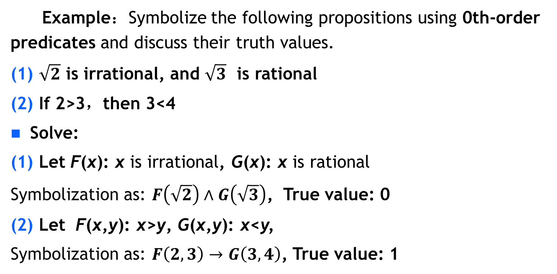
3.1.2 Individual Terms, Predicates, and Quantifiers
⤷ Predicate example (cont.)
Example：Symbolize the following propositions using 0th-order predicates and discuss their truth values.
(1) $\sqrt{2}$ is irrational, and $\sqrt{3}$ is rational
(2) If 2>3，then 3<4
Solve:
(1) Let F(x): x is irrational, G(x): x is rational
Symbolization as: $F\left(\sqrt{2}\right)∧G\left(\sqrt{3}\right)$, True value: 0
(2) Let F(x,y): x>y, G(x,y): x<y,
Symbolization as: $F\left(2,3\right)→G\left(3,4\right)$, True value: 1
Notes:
例： 将下述命题用0元谓词符号化, 并讨论它们的真值:
(1) 是无理数, 而 是有理数
(2) 如果2>3，则3<4
解 (1) 设F(x): x是无理数, G(x): x是有理数
符号化为
真值为0
(2) 设 F(x,y): x>y, G(x,y): x<y,
符号化为 F(2,3)→G(3,4)
真值为1

Slide 12
3.1.2 Individual Terms, Predicates, and Quantifiers
⤷ Quantifiers
Quantifiers: Words that indicate quantity.
Universal quantifier ∀: Indicates 'any', 'all', 'every', etc.
Such as: ∀x means "for all x in the domain of discourse."
∀xF(x) means "All x have the property F."
Existential quantifier ∃: Indicates 'there exists', 'there is', 'at least one', etc.
Such as:
∃x means "there exists an x in the domain of discourse."
∃xF(x) means "There exists an x that has the property F.
Notes:
量词: 表示数量的词
全称量词∀: 表示任意的, 所有的, 一切的等
如 ∀x 表示对个体域中所有的x
∀x F(x) 表示所有的x具有性质F
存在量词∃: 表示存在, 有的, 至少有一个等
如 ∃x 表示在个体域中存在x
∃x F(x) 表示存在x具有性质F

Slide 13
3.1 Basic Concepts of First-Order Logic
3.1.1 The Limitations of Propositional Logic
3.1.2 Individual Terms, Predicates, and Quantifiers
3.1.3 Symbolization of First-Order Logic
3.1.4 First-Order Logic Formulas and Classification
Notes:
Individual Constants, Individual Variables, Domain of Discourse, Universe of Discourse
Propositional Constants, Propositional Variables
Universal Quantifiers, Existential Quantifiers
First-order language L (alphabet, terms, atomic formulas, compound formulas)
Scope and bound variables, bound occurrences and free occurrences
Closed formulas
Interpretation of first-order language L
Tautologies, contradictions, and satisfiable formulas
Substitution examples
3.1.1 命题逻辑的局限性
3.1.2 个体词、谓词与量词
个体常项、个体变项、个体域、全总个体域
谓词常项、谓词变项
全称量词、存在量词
3.1.3 一阶逻辑命题符号化

Slide 14
3.1.3 Symbolization of First-Order Logic
⤷ Property Predicate vs. Unary Predicate
A property predicate can be regarded as a subset or a special case of a unary predicate, i.e., Property Predicate ⊆ Unary Predicate.
Item | Property Predicate P(x) | Unary Predicate P(x)
Definition | Describes an individual's inherent property or characteristic | Any predicate that applies to a single variable
Relation | Describes only the property of an object, without involving other objects | May describe an object's property or its role/relationship
Examples | Even(x) (x is even) Red(x) (x is red) | Student(x) (x is a student) Parent(x) (x is a parent)
Application | used to express individual properties | A general term for any predicate with one parameter
In machine learning model design, property predicates are typically used for classification tasks and can be utilized in feature selection, while unary predicates may involve object roles and relational inference.
Notes:
例： 在一阶逻辑中将下面命题符号化:
(1) 人都爱美; (2) 有人用左手写字
个体域分别取(a) 人类集合, (b) 全总个体域 .
解: (a) (1) 设F(x): x爱美, 符号化为 ∀x F(x)
(2) 设G(x): x用左手写字, 符号化为 ∃x G(x)
(b) 设M(x): x为人， F(x), G(x)同(a)中
(1) ∀x (M(x)→F(x))
(2) ∃ x (M(x)∧G(x))
M(x)称作
特性谓词
一元谓词: 表示事物的性质

Slide 15
3.1.3 Symbolization of First-Order Logic
⤷ Property Predicate vs. First-order Logic(e.g.)
Examples: Symbolizing the following propositions in first-order logic: (1) All people love beauty; (2) There is someone who writes with their left hand. Domain of discourse:(a) The set of humans; (b) The universal domain.
Solution: Domain of (a) :
(1) Let F(x): x loves beauty. Symbolized as ∀x F(x). (2) Let G(x): x writes with their left hand. Symbolized as ∃x G(x).
Solution: Domain of (b) : Let M(x): x is a person. F(x) and G(x) are the same as in (a). (1) Symbolized as ∀x (M(x) → F(x)). (2) Symbolized as ∃x (M(x) ∧ G(x)).
M(x) is called a characteristic predicate.
Notes:
例： 在一阶逻辑中将下面命题符号化:
(1) 人都爱美; (2) 有人用左手写字
个体域分别取(a) 人类集合, (b) 全总个体域 .
解: (a) (1) 设F(x): x爱美, 符号化为 ∀x F(x)
(2) 设G(x): x用左手写字, 符号化为 ∃x G(x)
(b) 设M(x): x为人， F(x), G(x)同(a)中
(1) ∀x (M(x)→F(x))
(2) ∃ x (M(x)∧G(x))
M(x)称作特性谓词

Slide 16
3.1.3 Symbolization of First-Order Logic
⤷ Property Predicate (e.g.)
Examples: Symbolize the following propositions and discuss their truth values:
(1) For all x, x²−3x+2=(x−1)(x−2);(2) There exists an x such that x+5=3.
Consider the following domains of discourse: (a) D₁=N (the set of natural numbers); (b) D₂ =R (the set of real numbers).
Solution: Let F(x):x²−3x+2=(x−1)(x−2), and G(x):x+5=3.
(a) Domain D₁=N :
(1) ∀xF(x) Truth value: 1 (True)
(2) ∃xG(x) Truth value: 0 (False)
(b) Domain D₂ =R :
(1) ∀xF(x) Truth value: 1 (True)
(2) ∃xG(x) Truth value: 1 (True)
Notes:
例： 将下列命题符号化, 并讨论其真值:
(1) 对任意的x, 均有x²-3x+2=(x-1)(x-2)
(2) 存在x, 使得x+5=3
分别取(a) 个体域D₁=N, (b) 个体域D₂=R
解： 记F(x): x²-3x+2=(x-1)(x-2), G(x): x+5=3
(a) (1) ∀x F(x) 真值为1
(2) ∃x G(x) 真值为0
(b) (1) ∀x F(x) 真值为1
(2) ∃x G(x) 真值为1

Slide 17
3.1.3 Symbolization of First-Order Logic
⤷ Examples
Example: Symbolize the following propositions:
(1) Rabbits run faster than turtles.
(2) Some rabbits run faster than all turtles.
(3) Not all rabbits run faster than turtles.
(4) There do not exist rabbits and turtles that run at the same speed.
Solution: Using a universal domain, let:
F(x): x is a rabbit.
G(y): y is a turtle.
H(x,y): x runs faster than y.
L(x,y): x and y run at the same speed.
(1) ∀x∀y(F(x)∧G(y)→H(x,y))
(2) ∃x(F(x)∧∀y(G(y)→H(x,y)))
(3) ¬∀x∀y(F(x)∧G(y)→H(x,y))
(4) ¬∃x∃y(F(x)∧G(y)∧L(x,y))
Notes:
例： 将下面命题符号化:
(1) 兔子比乌龟跑得快
(2) 有的兔子比所有的乌龟跑得快
(3) 并不是所有的兔子都比乌龟跑得快
(4) 不存在跑得一样快的兔子和乌龟
解： 用全总个体域, 令F(x): x是兔子, G(y): y是乌龟,
H(x,y): x比y跑得快, L(x,y): x和y跑得一样快
(1) ∀x∀y(F(x)∧G(y)→H(x,y))
(2) ∃x(F(x)∧(∀y (G(y)→H(x,y)))
(3) ¬ ∀x∀y(F(x)∧G(y)→H(x,y))
(4) ¬ ∃x∃y(F(x)∧G(y)∧L(x,y))

Slide 18
3.1.3 Symbolization of First-Order Logic
⤷Notices
The use of unary and n-ary predicates.
The distinction between universal and existential quantifiers.
When multiple quantifiers appear, their order cannot be arbitrarily swapped.
Such as: in the domain of real numbers R, let H(x,y): x+y=10
∀x∃yH(x,y) has a truth value of 1
∃y∀xH(x,y) has a truth value of 0
The symbolization of propositions is not unique.
Such as: based on the previous example, there are the following alternative symbolizations:
(1) ∀x(F(x)→∀y(G(y)→H(x,y))) (∀x∀y(F(x)∧G(y)→H(x,y))
(3) ∃x∃y(F(x)∧G(y)∧¬H(x,y)) (¬∀x∀y(F(x)∧G(y)→H(x,y)))
(4) ∀x∀y(F(x)∧G(y)→¬L(x,y)) (¬∃x∃y(F(x)∧G(y)∧L(x,y)))
Notes:
(1) 一元谓词和多元谓词的使用
(2) 全称量词和存在量词的区别
(3) 多个量词出现时, 不能随意交换顺序
如 在个体域R中, 记H(x,y): x+y=10
∀x∃y H(x,y) 真值为1
∃y∀x H(x,y) 真值为0
(4) 命题的符号化不唯一
如上例有如下变化的符号化形式：
(1) ∀x (F(x)→∀y(G(y)→H(x,y)))
(3) ∃x∃y(F(x)∧G(y)∧¬H(x,y))
(4) ∀x∀y(F(x)∧G(y)→¬L(x,y))

Slide 19
3.1 Basic Concepts of First-Order Logic
3.1.1 The Limitations of Propositional Logic
3.1.2 Individual Terms, Predicates, and Quantifiers
3.1.3 Symbolization of First-Order Logic
3.1.4 First-Order Logic Formulas and Classification
First-order language (alphabet, terms, atomic formulas, compound formulas)
Scope and bound variables, bound occurrences and free occurrences
Closed formulas
Interpretation of first-order language
Tautologies, contradictions, and satisfiable formulas
Substitution examples
Notes:
3.1.1 命题逻辑的局限性
3.1.2 个体词、谓词与量词
个体常项、个体变项、个体域、全总个体域
谓词常项、谓词变项
全称量词、存在量词
3.1.3 一阶逻辑命题符号化

Slide 20
3.1.4 First-Order Logic Formulas and Classification
⤷First-order language
A first-order language is a symbolic language used to express statements in first-order logic. Well-formed formulas are its constructed expressions, used to precisely express complex statements about objects and their relationships.
Definition 3.1: The alphabet of a first-order language is defined as follows:
(1) Individual constants: a,b,c,…,a_{i},b_{i},c_{i},…, where i≥1
(2) Individual variables: x,y,z,…,x_{i},y_{i},z_{i},…, where i≥1
(3) Function symbols: f,g,h,…,f_{i},g_{i},h_{i},…, where i≥1
(4) Predicate symbols: F,G,H,…,F_{i},G_{i},H_{i},…, where i≥1
(5) Quantifier symbols: ∀,∃
(6) Connective symbols: ¬,∧,∨,→,↔
(7) Parentheses and commas: ( ) , ,
Notes:
一阶语言是一种符号语言，用于表达一阶逻辑中的陈述，合式公式是其构造的表达式，用于精确地表达关于对象和它们的关系的复杂陈述。
定义3.1 一阶语言字母表定义如下：
(1) 个体常项：a, b, c, …, a_{i}, b_{i}, c_{i}, …, i ≥1
(2) 个体变项：x, y, z, …, x_{i}, y_{i}, z_{i}, …, i ≥1
(3) 函数符号：f, g, h, …, f_{i}, g_{i}, h_{i}, …, i ≥1
(4) 谓词符号：F, G, H, …, F_{i}, G_{i}, H_{i}, …, i ≥1
(5) 量词符号：∀, ∃
(6) 联结词符号：¬, ∧, ∨, →, ↔
(7) 括号与逗号：( ),

Slide 21
3.1.4 First-Order Logic Formulas and Classification
⤷Terms and atomic formulas of first-order logic
Definition 3.2：The definition of terms in a first-order language is as follows:
(1) Individual constants and individual variables are terms.
(2) If φ(x₁,x₂,…,x_{n}) is an arbitrary n-ary function symbol, and t₁,t₂,…,t_{n} are arbitrary terms, then φ(t₁,t₂,…,t_{n}) is also a term.
(3) All terms are obtained through a finite number of applications of (1) and (2).
Definition 3.3: Let R(x₁,x₂,…,x_{n}) be an arbitrary n-ary predicate symbol in a first-order language, and let t₁,t₂,…,t_{n} be arbitrary terms. Then, R(t₁,t₂,…,t_{n}) is called an atomic formula.
Notes:
定义3.2 一阶语言项的定义如下：
(1) 个体常项和个体变项是项.
(2) 若ϕ(x₁, x₂, …, x_{n})是任意的n元函数，t₁,t₂,…,t_{n}是任意
的n个项，则ϕ(t₁, t₂, …, t_{n}) 是项.
(3) 所有的项都是有限次使用 (1), (2) 得到的.
定义3.3 设R(x₁, x₂, …, x_{n})是一阶语言的任意n元谓词，t₁,t₂,…, t_{n}是任意n个项，则称R(t₁, t₂, …, t_{n})是原子公式

Slide 22
3.1.4 First-Order Logic Formulas and Classification
⤷Well-formed formula (predicate formulas or formulas.)
Definition 3.4：Well-formed formulas in a first-order language are defined as follows:
(1) Atomic formulas are well-formed formulas.
(2) If A is a well-formed formula, then ¬A is also a well-formed formula.
(3) If A and B are well-formed formulas, then (A∧B), (A∨B), (A→B), and (A↔B) are also well-formed formulas.
(4) If A is a well-formed formula, then ∀xA and ∃xA are also well-formed formulas.
(5) Only those expressions formed by a finite application of rules (1) through (4) are considered well-formed formulas.
Well-formed formulas are also referred to as predicate formulas or simply formulas.
Notes:
定义3.4一阶语言合式公式定义如下：
(1) 原子公式是合式公式
(2) 若A是合式公式, 则 (¬A)也是合式公式
(3) 若A, B是合式公式, 则(A∧B), (A∨B), (A→B), (A↔B)也
是合式公式
(4) 若A是合式公式, 则∀xA, ∃xA也是合式公式
(5) 只有有限次地应用(1)~(4)形成的符号串才是合式公式.
合式公式又称谓词公式, 简称公式

Slide 23
3.1.4 First-Order Logic Formulas and Classification
⤷Bound Variable and Bound Occurrences
Definition 3.5: In the formulas ∀xA and ∃A, x is called the bound variable (or binder), and A is the scope of the respective quantifier. In the scope of ∀x and ∃x , all occurrences of x are called bound occurrences. Variables in A that are not bound occurrences are called free occurrences.
Example: The formula ∀x(F(x,y)→∃yG(x,y,z))
The scope of ∀x is (F(x,y)→∃yG(x,y,z)), with x as the bound variable. Both occurrences of x are bound occurrences.
The scope of ∃y is G(x,y,z), with y as the bound variable.
The first occurrence of y is a free occurrence, and the second occurrence is a bound occurrence.
z is a free occurrence.
Notes:
y的第一次出现为自由出现, 第二次出现为约束出现 不在辖域中
定义3.5 在公式∀xA和∃xA中, 称x为指导变项（元）, A为相应量词的辖域. 在∀x和∃x的辖域中, x的所有出现称为约束出现，
A中不是约束出现的其他变项称为自由出现
例： 公式 ∀x(F(x,y)→∃yG(x,y,z))
∀x的辖域:(F(x,y)→∃yG(x,y,z))， 指导变元为x
∃y的辖域:G(x,y,z)， 指导变元为y
x的两次出现均为约束出现
y的第一次出现为自由出现, 第二次出现为约束出现
z为自由出现.

Slide 24
3.1.4 First-Order Logic Formulas and Classification
⤷Closed well-formed formula(closed formula)
Example: The formula ∀x(F(x)→∃xG(x))
The scope of ∀x is (F(x)→∃xG(x)), with x as the bound variable.
The scope of ∃x is G(x), with x as the bound variable.
Both occurrences of x are bound occurrences: the first in ∀x , and the second in ∃x.
Closed formula: A formula that contains no free occurrences of individual variables is called a closed well-formed formula, abbreviated as closed formula.
Notes:
在∀x和∃x的辖域中, x的所有出现称为约束出现
例：公式 ∀x(F(x)→∃xG(x))
∀x的辖域:(F(x)→∃xG(x))， 指导变元为x
∃x的辖域:G(x)， 指导变元为x
x的两次出现均为约束出现. 但是, 第一次出现的x是∀x中
的x, 第二次出现的x是∃x中的x.
闭式: 不含自由出现的个体变项的公式是封闭的合式公式，简称闭式.

Slide 25
3.1.4 First-Order Logic Formulas and Classification
⤷Interpretation, assignment, and quantification of formulas
A formula is merely a framework of logical expressions. To evaluate its truth value, the following tasks must be completed:
(1) Interpretation: Assign specific (semantic) meaning to this framework.
(2) Assignment: Under a given interpretation, assign values to the free variables in the formula.
(3) Quantification: Eliminate the free variables so that the truth value of the formula no longer depends on specific assignments but is determined by the overall situation of all possible assignments.
Notes:
公式提供了一个逻辑表达式的框架。
解释给这个框架赋予具体的意义。
赋值为公式中的自由变量指定值，使得我们可以评估公式在特定情况下的真值。
量化消除了自由变量，使得公式的真值不再依赖于具体的赋值，而是取决于所有可能赋值的整体情况。∃
公式（Formula）仅仅是逻辑表达式的框架，对其进行真值评估需要完成如下工作：
解释（Interpretation）给这个框架赋予具体的意（语）义
赋值（Assignment）是在给定的解释下为公式中的自由变量指定值
量化（Quantification）可以消除了自由变量，使公式的真值不再依赖于具体的赋值，而是取决于所有可能赋值的整体情况。
上述工作通常包含：①指定域；②为每个常量指定域中的元素；③为每个谓词符号提供指定域中的关系；④为每个函数符号指定一个实际的函数；⑤在特定解释下对公式中自由变量的具体取值。

Slide 26
3.1.4 First-Order Logic Formulas and Classification
⤷Interpretation, assignment, and quantification of formulas(e.g.)
Example: Formula ∀x(F(x) → G(x))
Specification1: Domain: All individuals. F(x): x is a person. G(x): x is Asian.
This formula translates to "For all x, if x is a person, then x is Asian." This is a false statement because not all people are Asian.
Specification 2: Domain: The set of real numbers. F(x): x > 10. G(x): x > 0.
This formula translates to "For all x, if x > 10, then x > 0." This is a true statement because any number greater than 10 is also greater than 0.
Example: Formula ∃xF(x,y)
Specification:Domain: The set of natural numbers. F(x,y): x = y. y = 0.
Since x,y both belong to the set of natural numbers N, for any y∈N, there exists an x=y such that the equation holds. Therefore, the statement is always true.
Notes:
公式提供了一个逻辑表达式的框架。
解释给这个框架赋予具体的意义。
赋值为公式中的自由变量指定值，使得我们可以评估公式在特定情况下的真值。
量化消除了自由变量，使得公式的真值不再依赖于具体的赋值，而是取决于所有可能赋值的整体情况。
例：公式∀x(F(x)→G(x))
指定1 个体域:全总个体域, F(x): x是人, G(x): x是黄种人
假命题
指定2 个体域:实数集, F(x): x>10, G(x): x>0
真命题
例： ∃xF(x,y)
指定 个体域:自然数集, F(x,y): x=y
y=0

Slide 27
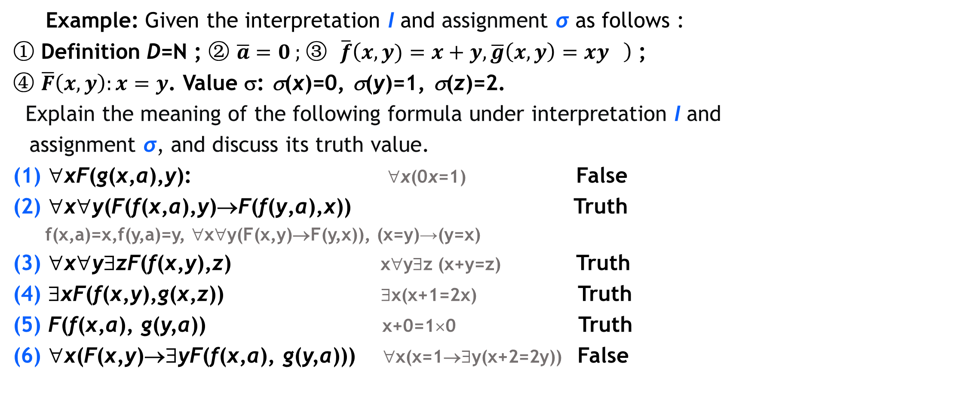
3.1.4 First-Order Logic Formulas and Classification
⤷Interpretation, assignment, and quantification of formulas(e.g.)
Example: Given the interpretation I and assignment σ as follows :
① Definition D=N ; ② $\overline{a}=0$ ; ③ $\overline{f}\left(x,y)=x+y,\overline{g}\left(x,y\right)=xy \right)$ ;
④ $\overline{F}\left(x,y\right):x=y$. Value σ: σ(x)=0, σ(y)=1, σ(z)=2.
Explain the meaning of the following formula under interpretation I and assignment σ, and discuss its truth value.
(1) ∀xF(g(x,a),y): ∀x(0x=1) False
(2) ∀x∀y(F(f(x,a),y)→F(f(y,a),x)) Truth
f(x,a)=x,f(y,a)=y, ∀x∀y(F(x,y)→F(y,x)), (x=y)→(y=x)
(3) ∀x∀y∃zF(f(x,y),z) x∀y∃z (x+y=z) Truth
(4) ∃xF(f(x,y),g(x,z)) ∃x(x+1=2x) Truth
(5) F(f(x,a), g(y,a)) x+0=1×0 Truth
(6) ∀x(F(x,y)→∃yF(f(x,a), g(y,a))) ∀x(x=1→∃y(x+2=2y)) False

Slide 28
3.1.4 First-Order Logic Formulas and Classification
⤷Classification of first-order Logic formulas
Tautology (logically valid formula): no false interpretation and assignment.
Contradiction (contravalid formula): no true interpretation and assignment.
Satisfiable formula: at least one true interpretation and assignment.
A tautology is a satisfiable formula, but the converse is not true.
In first-order logic, the satisfiability (tautology, contradiction) of a formula is undecidable, meaning there is no algorithm that can determine in finite steps whether a given formula is satisfiable (a tautology, a contradiction).
Notes:
永真式(逻辑有效式): 无成假解释和赋值
矛盾式(永假式): 无成真解释和赋值
可满足式: 至少有一个成真解释和赋值
永真式为可满足式，但反之不真
在一阶逻辑中, 公式的可满足性(永真性,永假性)是不可判定的,即不存在算法能在有限步内判断任给的公式是否是可满足式(永真式,矛盾

Slide 29
3.1.4 First-Order Logic Formulas and Classification
⤷Substitution instance of a propositional formula
Definition 3.6： Let A₀ be a propositional formula containing propositional variables p₁,p₂,…,p_{n}, and let A₁,A₂,…,A_{n} be predicate formulas. The formula A, obtained by uniformly replacing each p_{i} (for 1≤i≤n) in A₀ with A_{i}, is called a substitution instance of A₀.
Such as: F(x)→G(x) and ∀xF(x)→∃yG(y) are substitution instances of p→q.
Theorem 3.2: All substitution instances of a tautology are logically valid, and all substitution instances of a contradiction are contradictions.
Notes:
定义3.9 设A₀是含命题变项p₁, p₂, …,p_{n}的命题公式, A₁,A₂,…, A_{n}是n个谓词公式, 用A_{i}处处代替A₀中的p_{i}(1≤i≤n), 所得公式A称为A₀的代换实例.
例如 F(x)→G(x), ∀xF(x)→∃yG(y) 等都是p→q的代换实例
定理3.2 重言式的代换实例都是永真式，矛盾式的代换实例都是矛盾式.

Slide 30

3.1.4 First-Order Logic Formulas and Classification
⤷Classification of first-order Logic formulas(e.g.)
Example: Determine the type of the following formula:
(1) ∀x(F(x)→G(x))
I₁: D₁=R, $\overline{F}\left(x\right):\text{x} \text{integer}$, $\overline{G}\left(x\right):\text{x} \text{is} \text{rational}$. (1) is a true proposition.
I₂: D₂=R, $\overline{F}\left(x\right):\text{x} \text{integer}$, $\overline{G}\left(x\right):\text{x} \text{is} \text{natural} \text{number}$. (1) is a false proposition. (1) is a satisfiable formula (not logically valid formula).
(2) ¬(∀xF(x,y))∨(∀xF(x,y)) ,
¬p∨p substitution instances , ¬p∨p tautology, (2) is a tautology.
(3) ¬ (∀xF(x)→∃yG(y)) ∧ ∃yG(y),
¬(p→q)∧q substitution instances, ¬(p→q)∧q contradiction, (3) is a contradiction.
Notes:
取解释I₁, D₁=R, :x是整数, :x是有理数, 真命题
取解释I₂, D₂=R, :x是整数, :x是自然数, 假命题
1)非永真式的可满足式
2）永真式
3）矛盾式

Slide 31

3.1.4 First-Order Logic Formulas and Classification
⤷Classification of first-order Logic formulas(e.g.)
Example: Determine the type of the following formula:
(4) ∀xF(x,y)
I₁: D₁=N, $\overline{F}\left(x,y\right):\text{x}≥\text{y}$, Assign σ(y)=0.
(4) is a true proposition.
I₂: D₂=N,$\overline{ F}\left(x,y\right):\text{x}≥\text{y}$, Assign σ(y)=1.
(4) is a false proposition.
(4) is a satisfiable formula (not logically valid formula).
Notes:
取解释I₁, D₁=R, :x是整数, :x是有理数, 真命题
取解释I₂, D₂=R, :x是整数, :x是自然数, 假命题
1)非永真式的可满足式
2）永真式
3）矛盾式

Slide 32
3.1 Basic Concepts of First-Order Logic• Brief summary
Objective :
Key Concepts ：

Slide 33
Discrete Mathematics 2025 Spring
魏可佶 kejiwei@tongji.edu.cn

Slide 34
Chapter 3： First Order Logic
3.1 Basic Concepts of First-Order Logic
3.2 Equivalence Calculus of First-Order Logic
Notes:
3.1 一阶逻辑基本概念
3.2 一阶逻辑等值演算

Slide 35
3.2 Equivalence Calculus of First-Order Logic
3.2.1 First-Order Logic Equivalences and Substitution Rules Basic Equivalences Substitution Rules, Renaming Rules
3.2.2 Prenex normal form of first-order logic
Notes:
3.2.1 一阶逻辑等值式与置换规则
基本等值式
置换规则、换名规则
3.2.2 一阶逻辑前束范式

Slide 36
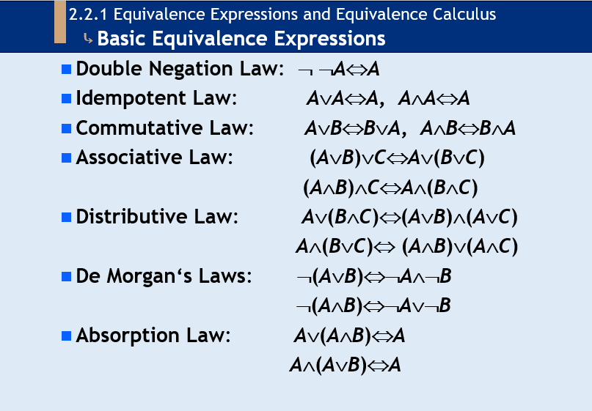
3.2.1 First-Order Logic Equivalences and Substitution Rules
⤷ Review of Basic Equivalence Expressions

Slide 37
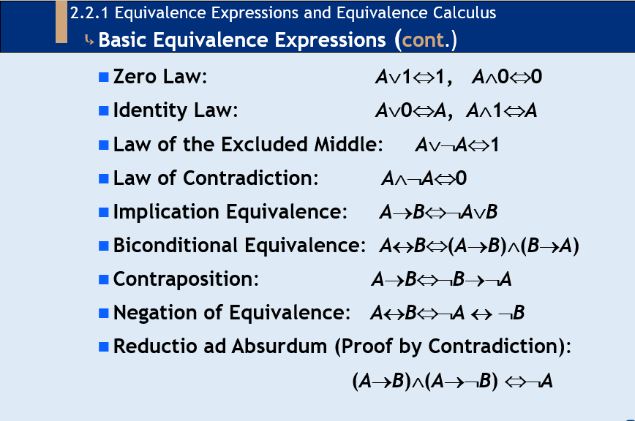
3.2.1 First-Order Logic Equivalences and Substitution Rules
⤷ Review of Basic Equivalence Expressions (cont.)

Slide 38
3.2.1 First-Order Logic Equivalences and Substitution Rules
⤷ Tautology A↔B vs. Equivalence A ⇔ B
Definition 3.7: If A↔B is a tautology (a valid formula), then A and B are called equivalent, denoted by A ⇔ B, and A B is referred to as an equivalence.
There are 24 propositional basic equivalences and their substitution examples, all of which are equivalences in first-order logic.
For example:
∀xF(x)→∃yG(y) ⇔ ¬∀xF(x)∨∃yG(y)
¬(∀xF(x)∨∃yG(y)) ⇔ ¬∀xF(x)∧¬∃yG(y) and so on
Notes:
定义3.10 若A↔B是永真式（有效式）, 则称A与B是等值的, 记作 A⇔B, 并称A⇔B为等值式
24个命题基本等值式及其代换实例都是一阶逻辑的等值式
如，∀xF(x)→∃yG(y) ⇔ ¬∀xF(x)∨∃yG(y)
¬(∀xF(x)∨∃yG(y)) ⇔ ¬∀xF(x)∧¬∃yG(y) 等
消去量词等值式
设D={a₁,a₂,…,a_{n}}
∀xA(x)⇔A(a₁)∧A(a₂)∧…∧A(a_{n})
∃xA(x)⇔A(a₁)∨A(a₂)∨…∨A(a_{n})

Slide 39
3.2.1 First-Order Logic Equivalences and Substitution Rules
⤷ Quantifier Elimination Equivalences
Quantifier Elimination Equivalences: To transform logical expressions to remove quantifiers (∃, ∀), yielding an equivalent quantifier-free form.
Let D={a₁,a₂,…,a_{n}}
∀xA(x)⇔A(a₁)∧A(a₂)∧…∧A(a_{n})
∃xA(x)⇔A(a₁)∨A(a₂)∨…∨A(a_{n})
Notes:
定义3.10 若A↔B是永真式（有效式）, 则称A与B是等值的, 记作 A⇔B, 并称A⇔B为等值式
24个命题基本等值式及其代换实例都是一阶逻辑的等值式
如，∀xF(x)→∃yG(y) ⇔ ¬∀xF(x)∨∃yG(y)
¬(∀xF(x)∨∃yG(y)) ⇔ ¬∀xF(x)∧¬∃yG(y) 等
消去量词等值式
设D={a₁,a₂,…,a_{n}}
∀xA(x)⇔A(a₁)∧A(a₂)∧…∧A(a_{n})
∃xA(x)⇔A(a₁)∨A(a₂)∨…∨A(a_{n})

Slide 40
3.2.1 First-Order Logic Equivalences and Substitution Rules
⤷ Quantifier Negation Equivalences
Quantifier Negation Equivalences: To convert quantifiers (∀ and ∃) and negation (¬), changing the scope of the negation without altering the logical meaning.
Let A(x) be a formula in which x appears freely.
¬∀xA(x)⇔ ∃x ¬A(x)
¬ ∃xA(x)⇔∀x ¬A(x)
Notes:
定义3.10 若A↔B是永真式（有效式）, 则称A与B是等值的, 记作 A⇔B, 并称A⇔B为等值式
24个命题基本等值式及其代换实例都是一阶逻辑的等值式
如，∀xF(x)→∃yG(y) ⇔ ¬∀xF(x)∨∃yG(y)
¬(∀xF(x)∨∃yG(y)) ⇔ ¬∀xF(x)∧¬∃yG(y) 等
消去量词等值式
设D={a₁,a₂,…,a_{n}}
∀xA(x)⇔A(a₁)∧A(a₂)∧…∧A(a_{n})
∃xA(x)⇔A(a₁)∨A(a₂)∨…∨A(a_{n})

Slide 41
3.2.1 First-Order Logic Equivalences and Substitution Rules
⤷ Quantifier Negation Equivalences
Quantifier Distribution Equivalences: To allocate or restructure quantifiers (∀, ∃) to interact correctly with logical operations (∧, ∨, →) while preserving logical equivalence.
∀x(A(x)∧B(x))⇔∀xA(x)∧∀xB(x)
∃x(A(x)∨B(x))⇔∃xA(x)∨∃xB(x)
Attention：∀ to ∨，∃ to ∧ no Quantifier Distribution Equivalences.
Notes:
量词否定等值式
设A(x)是含x自由出现的公式
¬∀xA(x)⇔ ∃x ¬A(x)
¬ ∃xA(x)⇔∀x ¬A(x)
量词分配等值式
∀x(A(x)∧B(x))⇔∀xA(x)∧∀xB(x)
∃x(A(x)∨B(x))⇔∃xA(x)∨∃xB(x)
注意：∀对∨，∃对∧无分配律

Slide 42
3.2.1 First-Order Logic Equivalences and Substitution Rules
⤷ Quantifier scope reduction and expansion equivalences
Quantifier scope reduction and expansion equivalences：To adjust the scope of quantifiers (∀, ∃) while preserving logical equivalence.
Let A(x) be a formula in which x appears freely, and let B be a formula in which x does not appear.
Universal quantifier Existential quantifier
∀x(A(x)∨B)⇔∀xA(x)∨B ∃x(A(x)∨B)⇔∃xA(x)∨B
∀x(A(x)∧B)⇔∀xA(x)∧B ∃x(A(x)∧B)⇔∃xA(x)∧B
∀x(A(x)→B)⇔∃xA(x)→B ∃x(A(x)→B)⇔∀xA(x)→B
∀x(B→A(x))⇔B→∀xA(x) ∃x(B→A(x))⇔B→∃xA(x)
Notes:
量词辖域收缩与扩张等值式
设A(x)是含x自由出现的公式，B中不含x的出现
关于全称量词的：关于存在量词的:

Slide 43
3.2.1 First-Order Logic Equivalences and Substitution Rules
⤷ Substitution and Renaming Rules
Substitution Rule： Let Φ(A) be a formula containing formula A, and Φ(B) be the formula obtained by replacing all occurrences of A in Φ(A) with formula B. Then, Φ(A) ⇔ Φ(B).
Renaming Rule： In a formula A, change the bound variables (and their occurrences within the scope of the quantifier) of a quantifier to an individual term that has not appeared within the scope of that quantifier. The rest of the formula remains unchanged, and the resulting formula is denoted as A'. Then, A' ⇔ A.
Notes:
置换规则 设Φ(A)是含公式A的公式, Φ(B)是用公式B取
代Φ(A)中的所有A得到的公式, 则Φ(A)⇔Φ(B)
换名规则 将公式A中某量词的指导变元及其在辖域内的
所有约束出现改成该量词辖域内未曾出现的某个个体变
项, 其余部分不变, 记所得公式为A′, 则A′⇔A
置换可以用来变换表达式，寻找等价的表达形式
换名可以消除变量名冲突、澄清量词作用域
置换时被替换的项不应该变成某个量词范围内的变量
换名时只有被量词绑定的变量名被更改，其余的公式结构应保持不变

Slide 44
3.2.1 First-Order Logic Equivalences and Substitution Rules
⤷ Substitution and Renaming Rules
Note:
(1) Substitution can be used to transform expressions and find equivalent forms of expression.
(2) Renaming can eliminate variable name conflicts and clarify the scope of quantifiers.
(3) When substituting, the replaced terms should not become variables within the scope of some quantifier.
(4) When renaming, only the variable names bound by quantifiers are changed, and the rest of the formula structure remains unchanged.
Notes:
置换规则 设Φ(A)是含公式A的公式, Φ(B)是用公式B取
代Φ(A)中的所有A得到的公式, 则Φ(A)⇔Φ(B)
换名规则 将公式A中某量词的指导变元及其在辖域内的
所有约束出现改成该量词辖域内未曾出现的某个个体变
项, 其余部分不变, 记所得公式为A′, 则A′⇔A
置换可以用来变换表达式，寻找等价的表达形式
换名可以消除变量名冲突、澄清量词作用域
置换时被替换的项不应该变成某个量词范围内的变量
换名时只有被量词绑定的变量名被更改，其余的公式结构应保持不变

Slide 45
3.2.1 First-Order Logic Equivalences and Substitution Rules
⤷ Renaming Rules(e.g.)
Example: Eliminate the individual variables that appear both in the constraints and as free variables in the equation.
(1) ∀xF(x,y,z) → ∃yG(x,y,z)
⇔ ∀uF(u,y,z) → ∃yG(x,y,z)
⇔ ∀uF(u,y,z) → ∃vG(x,v,z) （Renaming Rule Equivalence)
Avoid variable confusion and improve expression readability and consistency.
(2) ∀x(F(x,y) → ∃yG(x,y,z))
⇔ ∀x(F(x,y) → ∃tG(x,t,z)) （Renaming Rule Equivalence）
Only changed the bound variable name of the existential quantifier y.

Slide 46
3.2.1 First-Order Logic Equivalences and Substitution Rules
⤷ Quantifier scope reduction and expansion equivalences(e.g.)
Example: Let the domain of individuals be D={a,b,c}, eliminate the quantifiers in the following formula:
(1) ∀x(F(x)→G(x))
⇔ (F(a)→G(a))∧(F(b)→G(b))∧(F(c)→G(c))
(2) ∀x(F(x)∨∃yG(y))
⇔ ∀xF(x)∨∃yG(y) （ Quantifier scope reduction ）
⇔(F(a)∧F(b)∧F(c))∨(G(a)∨G(b)∨G(c))
(3) ∃x∀yF(x,y)
⇔ ∃x(F(x,a)∧F(x,b)∧F(x,c))
⇔ (F(a,a)∧F(a,b)∧F(a,c))∨(F(b,a)∧F(b,b)∧F(b,c)) ∨(F(c,a)∧F(c,b)∧F(c,c))
Notes:
量词辖域收缩

Slide 47
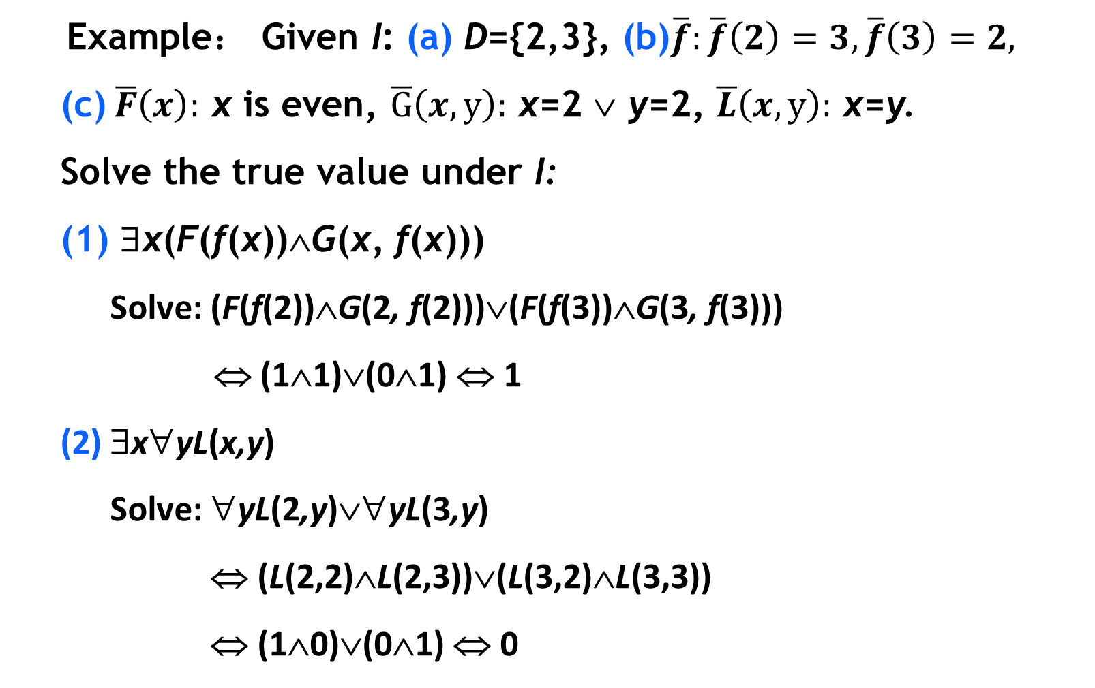
3.2.1 First-Order Logic Equivalences and Substitution Rules
⤷ Quantifier scope reduction and expansion equivalences(e.g.)
Example： Given I: (a) D={2,3}, (b)$\overline{f}:\overline{f}\left(2\right)=3,\overline{f}\left(3\right)=2,$
(c) $\overline{F}\left(x\right):$ x is even, $\overline{G}\left(x,y\right):$ x=2 ∨ y=2, $\overline{L}\left(x,y\right):$ x=y.
Solve the true value under I:
(1) ∃x(F(f(x))∧G(x, f(x)))
Solve: (F(f(2))∧G(2, f(2)))∨(F(f(3))∧G(3, f(3)))
⇔ (1∧1)∨(0∧1) ⇔ 1
(2) ∃x∀yL(x,y)
Solve: ∀yL(2,y)∨∀yL(3,y)
⇔ (L(2,2)∧L(2,3))∨(L(3,2)∧L(3,3))
⇔ (1∧0)∨(0∧1) ⇔ 0

Slide 48
3.2.1 First-Order Logic Equivalences and Substitution Rules
⤷ Prove the equivalence using transformation rules (e.g.)
Example： Prove the following equivalence:
¬ ∃x(M(x)∧F(x)) ⇔ ∀x(M(x)→ ¬F(x))
Prove:
Left ⇔ ∀x ¬(M(x)∧F(x)) （De Morgan's laws for quantifiers）
⇔ ∀x(¬M(x)∨¬F(x))
⇔ ∀x(M(x)→ ¬F(x))
The proof applies three key logical transformation rules:
quantifier negation, De Morgan’s laws, and implication equivalence.

Slide 49
3.2 Equivalence Calculus of First-Order Logic
3.2.1 First-Order Logic Equivalences and Substitution Rules Basic Equivalences Substitution Rules, Renaming Rules
3.2.2 Prenex normal form of first-order logic
Notes:
3.2.1 一阶逻辑等值式与置换规则
基本等值式
置换规则、换名规则
3.2.2 一阶逻辑前束范式

Slide 50
3.2.2 Prenex normal form of first-order logic
⤷ Prenex normal form
Definition 3.8: Let A be a first-order logic formula. If A has the form Q₁x₁Q₂x₂…Q_{k}x_{k} B
where each Q_{i} is either ∀ or ∃ (for 1≤i≤k), and B is a formula without quantifiers, then A is called a prenex normal form.
Examples:
∀x∃y(F(x)→(G(y)∧H(x,y))) (prenex normal form)
∀x¬(F(x)∧G(x)) (prenex normal form)
∀x(F(x)→∃y(G(y)∧H(x,y))) (not prenex normal form)
¬∃x(F(x)∧G(x)) (not prenex normal form)
Notes:
前束范式（Prenex Normal Form）是一种特殊形式的逻辑公式，其中所有的量词都被移动到公式的前面，形成一个连续的量词前缀，而不涉及任何逻辑运算符。
否定符号“¬”出现在存在量词“∃”之前，这意味着公式并不是前束范式。在前束范式中，我们不会在量词后面的矩阵部分看到任何量词，而且所有的否定操作都会作用于矩阵的原子公式，而不是量词。
量词的否定规则允许我们将 ¬∃x 转换为 ∀x¬。
¬∃x[F(x) ∧ ¬G(x)] 可以转换为 ∀x¬[F(x) ∧ ¬G(x)]，进一步转换为 ∀x[¬F(x) ∨ G(x)]，这是前束范式，因为所有量词都移动到了公式的前面。
定义3.11 设A为一个一阶逻辑公式, 若A具有如下形式
Q₁x₁Q₂x₂…Q_{k}x_{k} B
则称A为前束范式, 其中Q_{i} 为∀或∃, 1≤i≤k, B为不含量词的
公式.
例如 ∀x∃y(F(x)→(G(y)∧H(x,y)))
∀x¬(F(x)∧G(x))
是前束范式
∀x(F(x)→∃y(G(y)∧H(x,y)))
¬∃x(F(x)∧G(x))
不是前束范式

Slide 51
3.2 Equivalence Calculus of First-Order Logic • Brief summary
Objective :
Key Concepts ：

Slide 52
Chapter 3： First Order Logic • Brief summary
Objective :
Key Concepts ：

